Slide 1
High Fidelity Project
The University Portal

Slide 2
Project Scope and Purpose of Design
Introduction
Project Scope
The goals
Constraints

Slide 3
Tasks
Log into Account
Course Details
Course Registration
Dropping Courses
Recovering User Password

Slide 4
Technologies used
HTML
CSS
Javascript

Slide 5
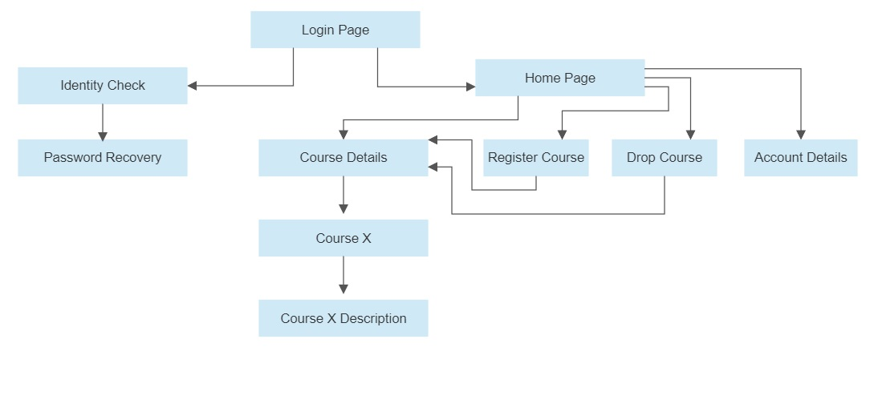
Walkthrough
How the features was tested?

Slide 6
Low fidelity vs High fidelity

Slide 7
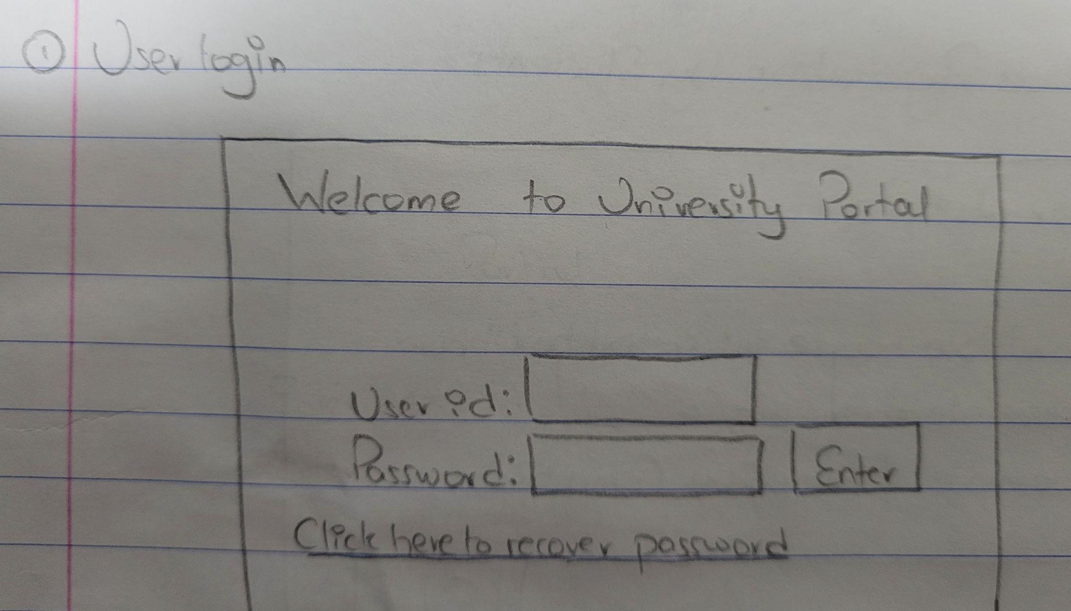
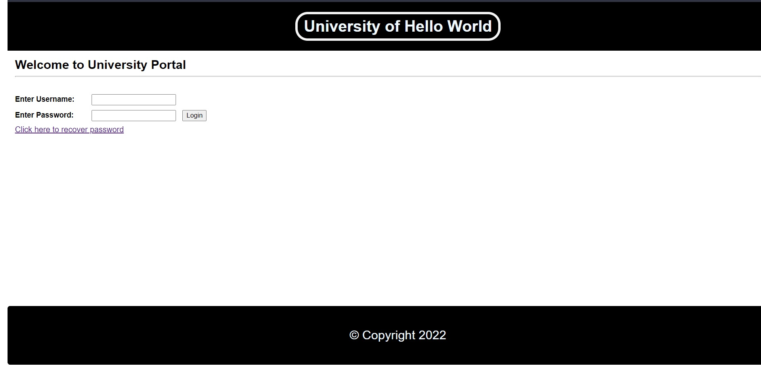
User login : Low vs High

Slide 8
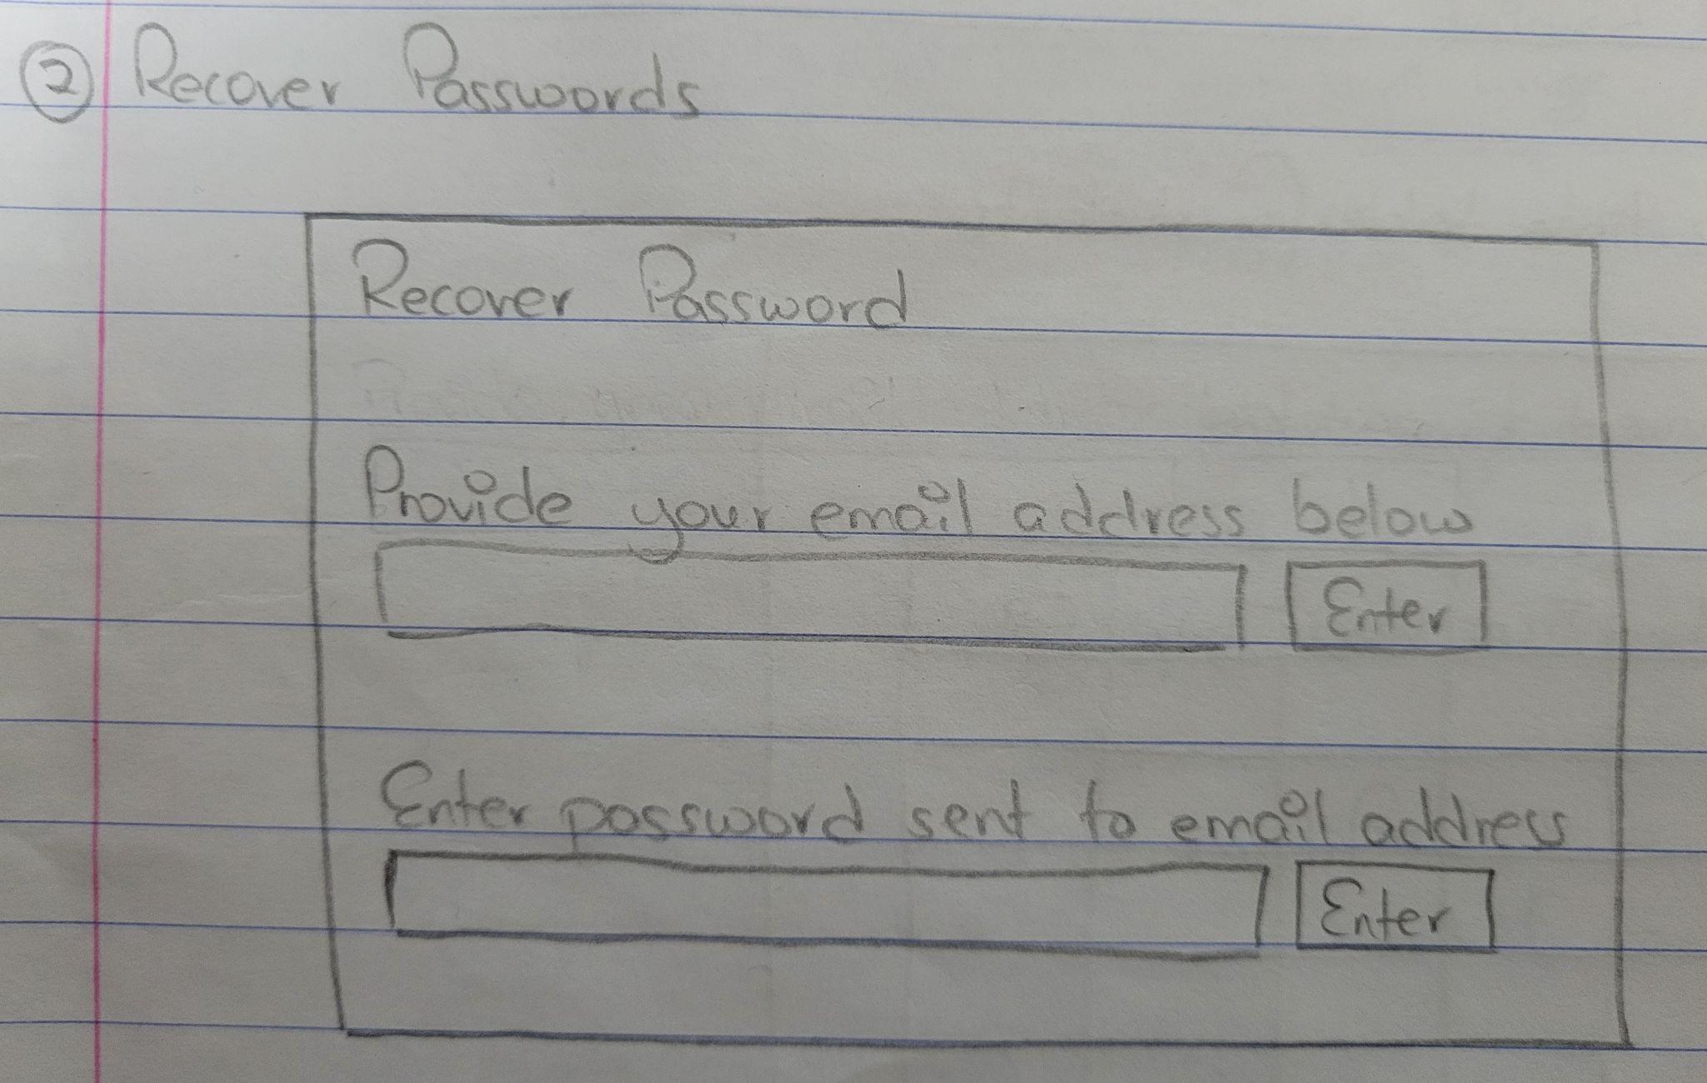
Recover Passwords : Low

Slide 9
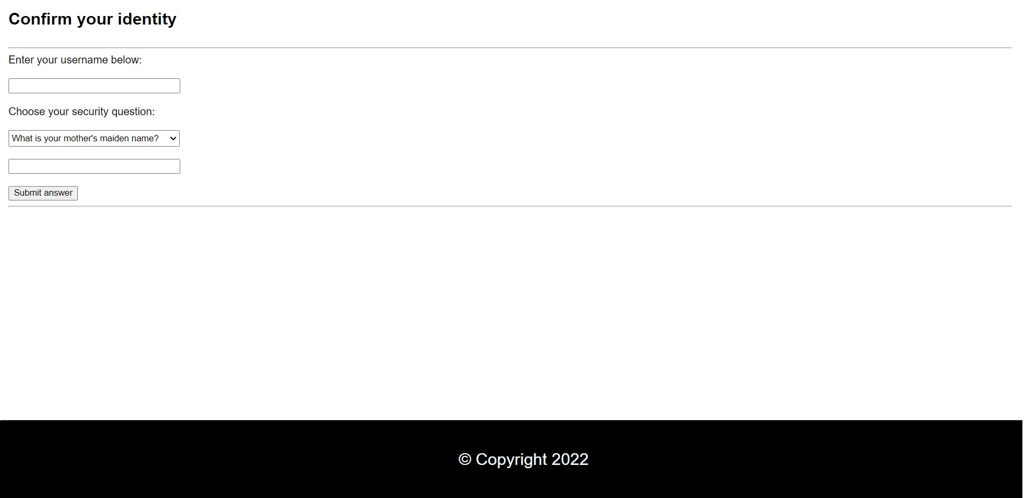
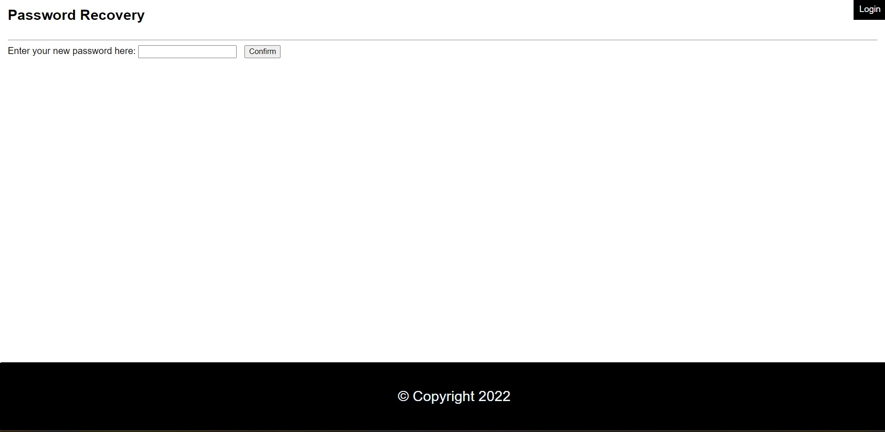
Recover Passwords: High
1 2

Slide 10
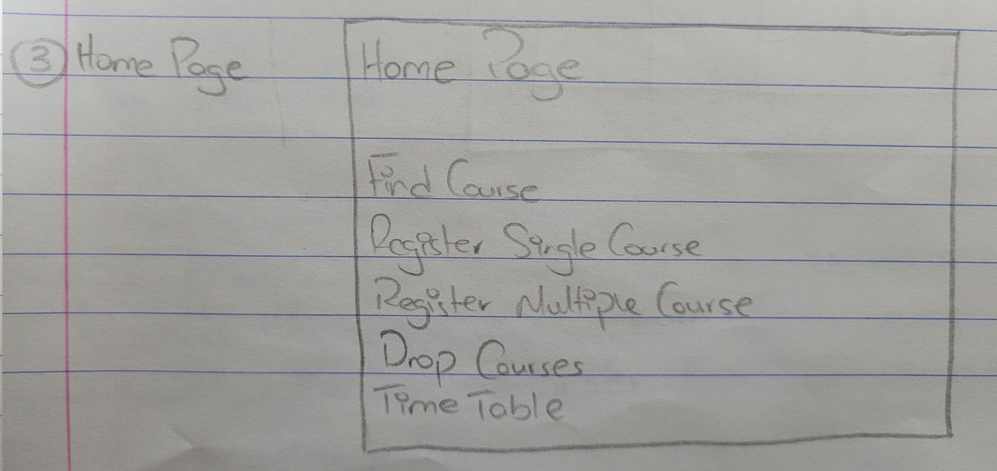
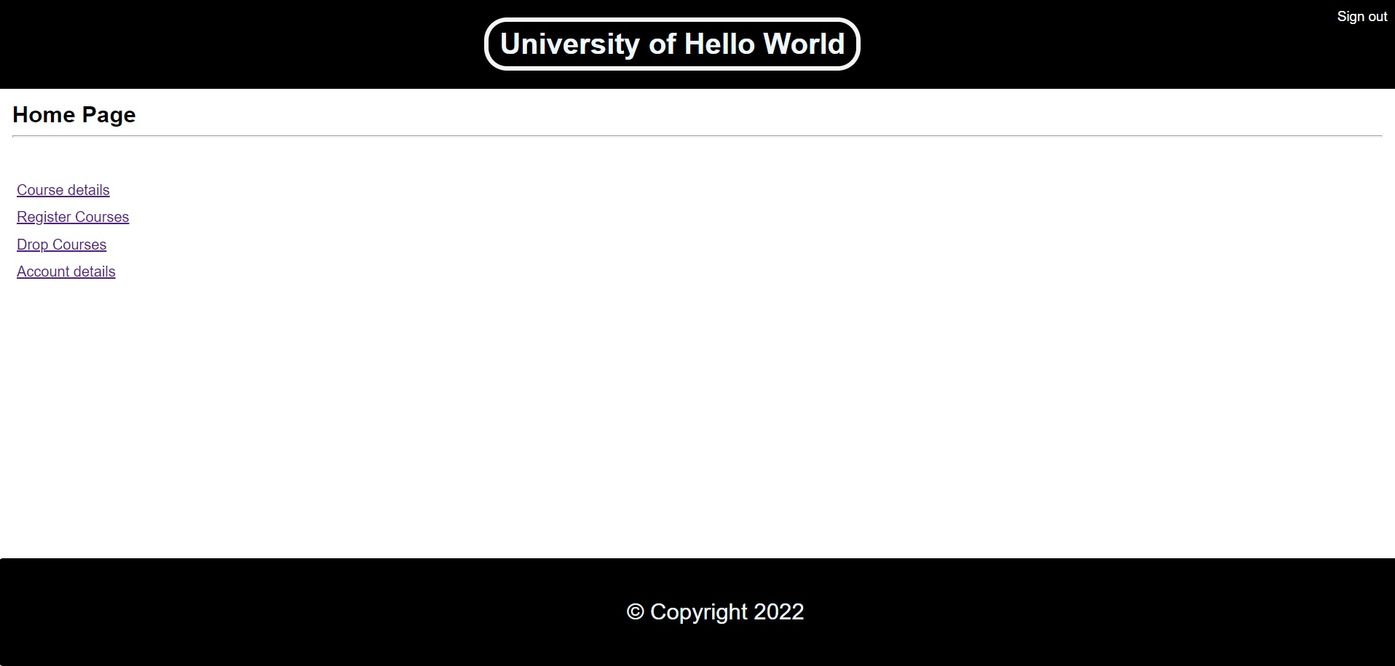
Home Page: Low vs High

Slide 11
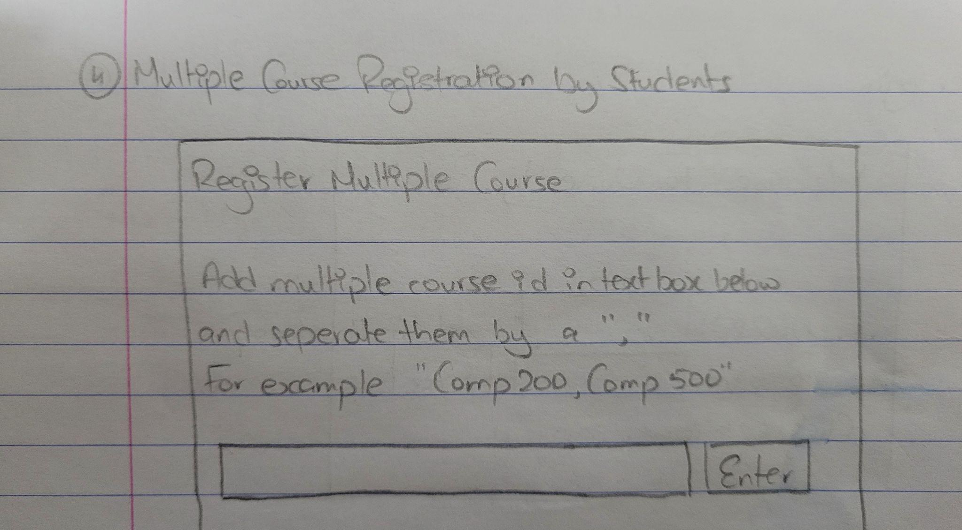
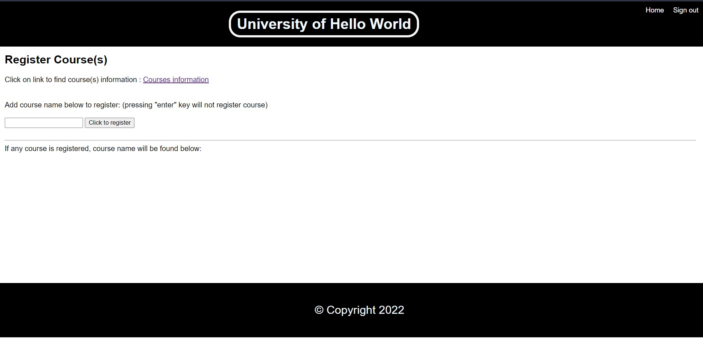
Register Course: Low vs High

